Slide 1

TOPCAT
Tool for OPerations on Catalogues And Tables
'Does what you want with tables'
Mat Schofield

Slide 2
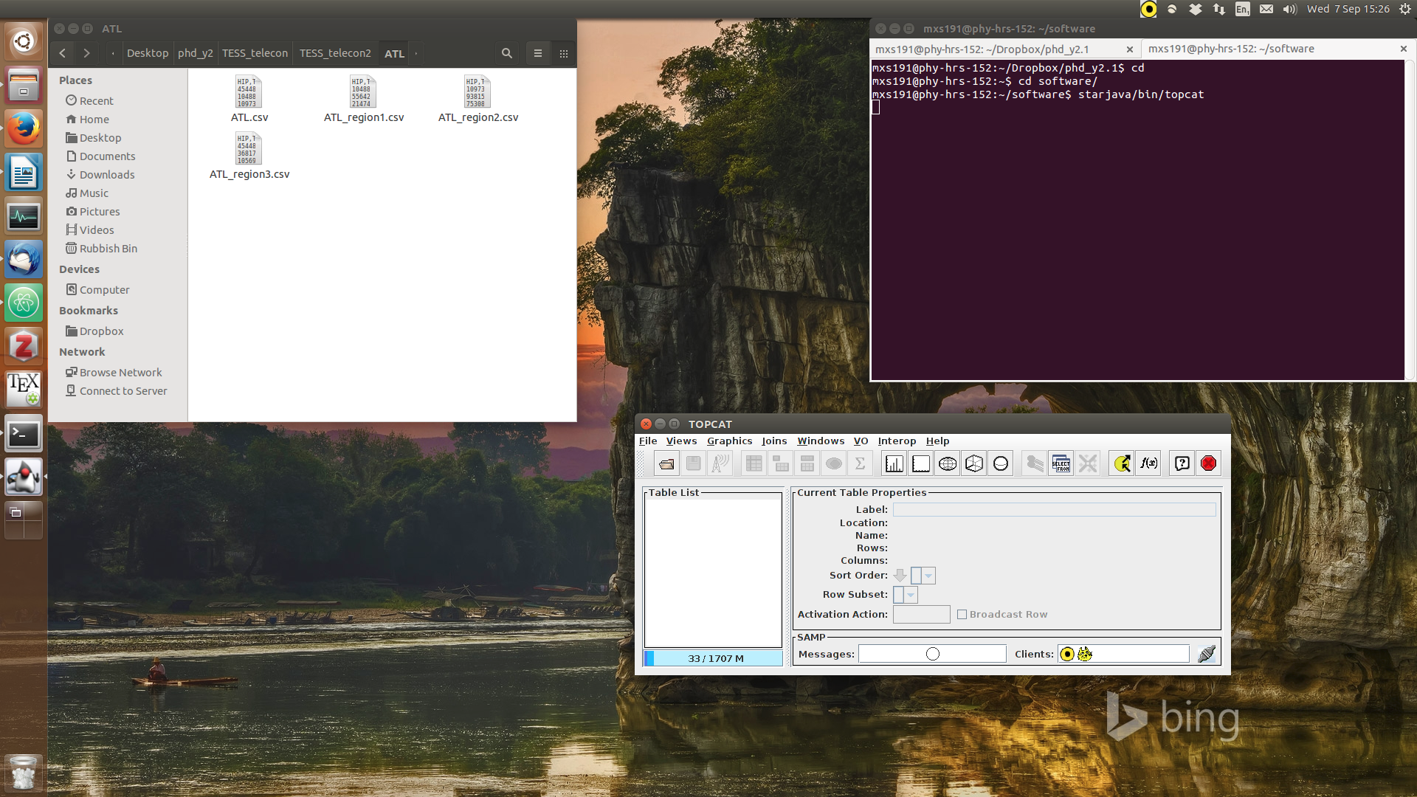
Loading TOPCAT

Slide 3
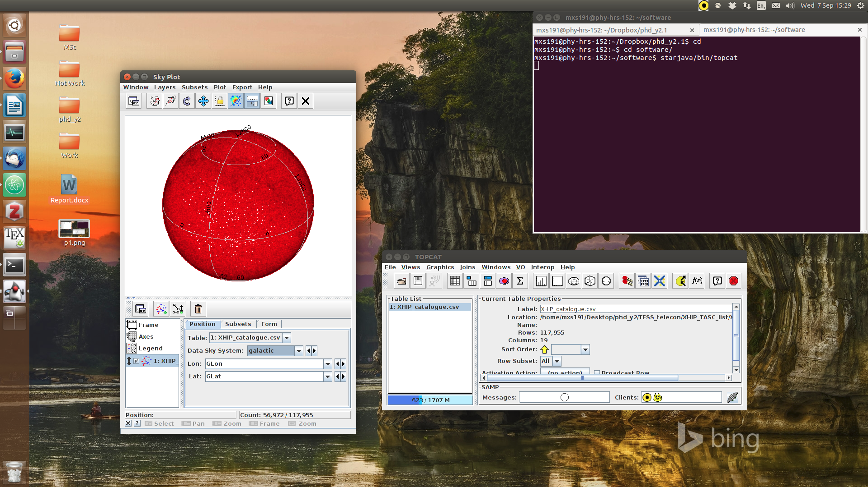
Loading data and Sky Plotting

Slide 4
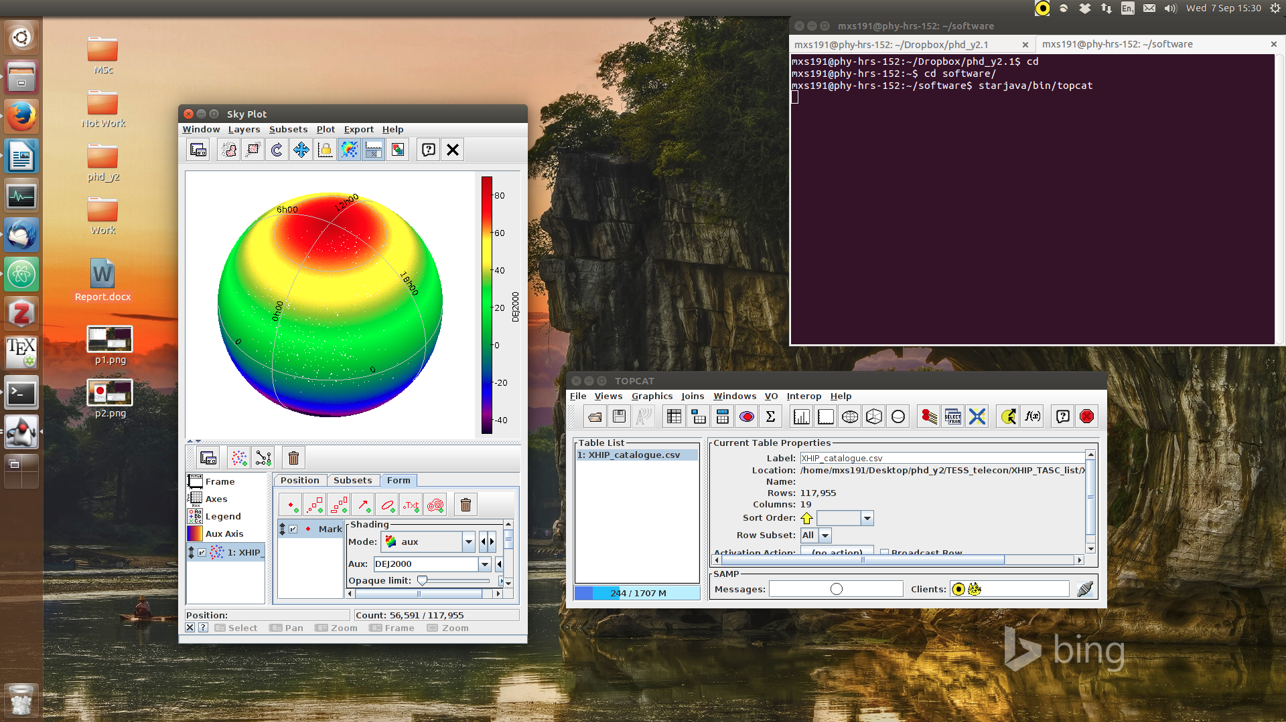
Colourbar

Slide 5
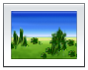
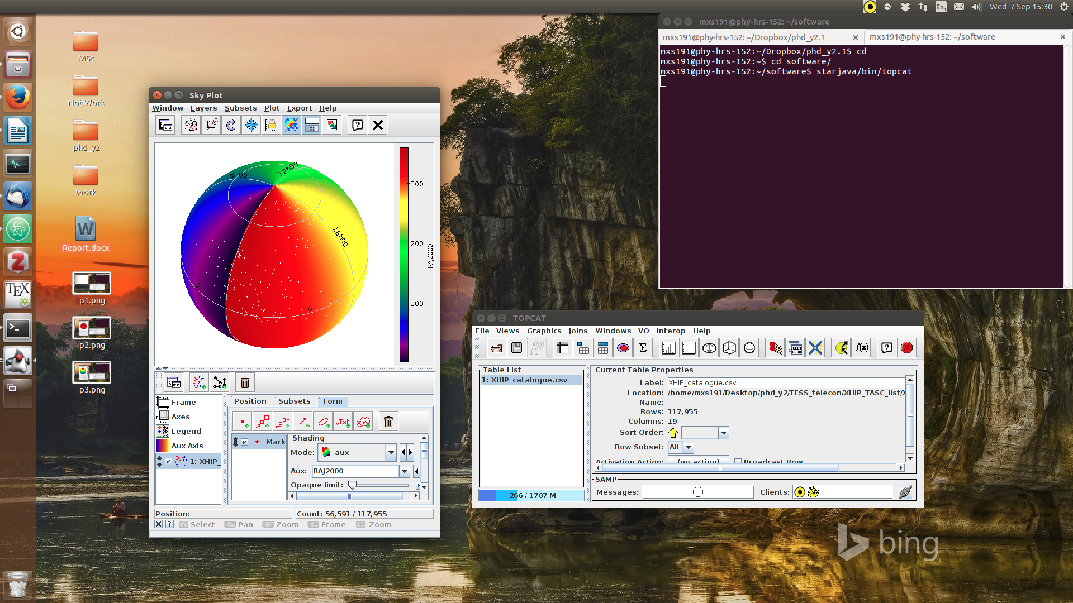
Colourbar

Slide 6
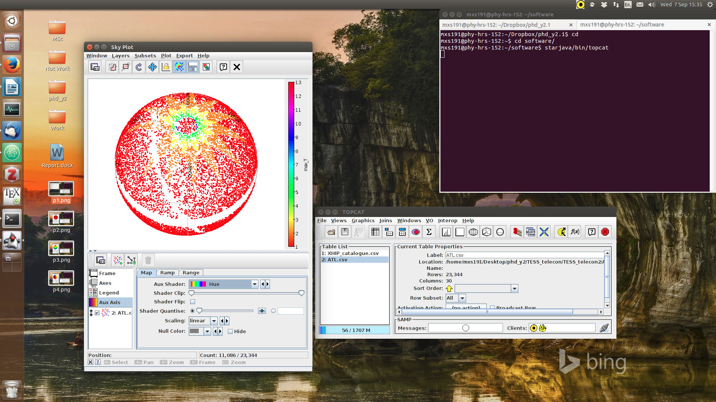
Colourbar

Slide 7
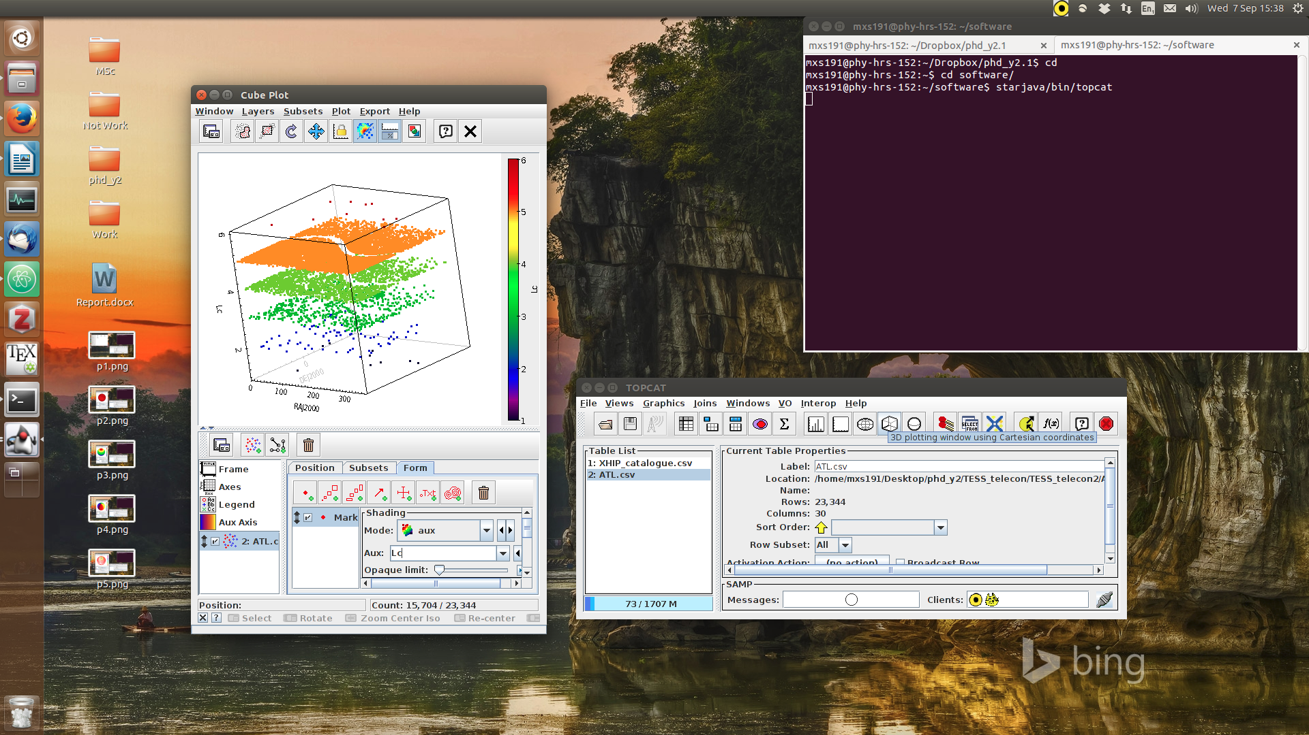
3D plotting in cartesian coordinates

Slide 8
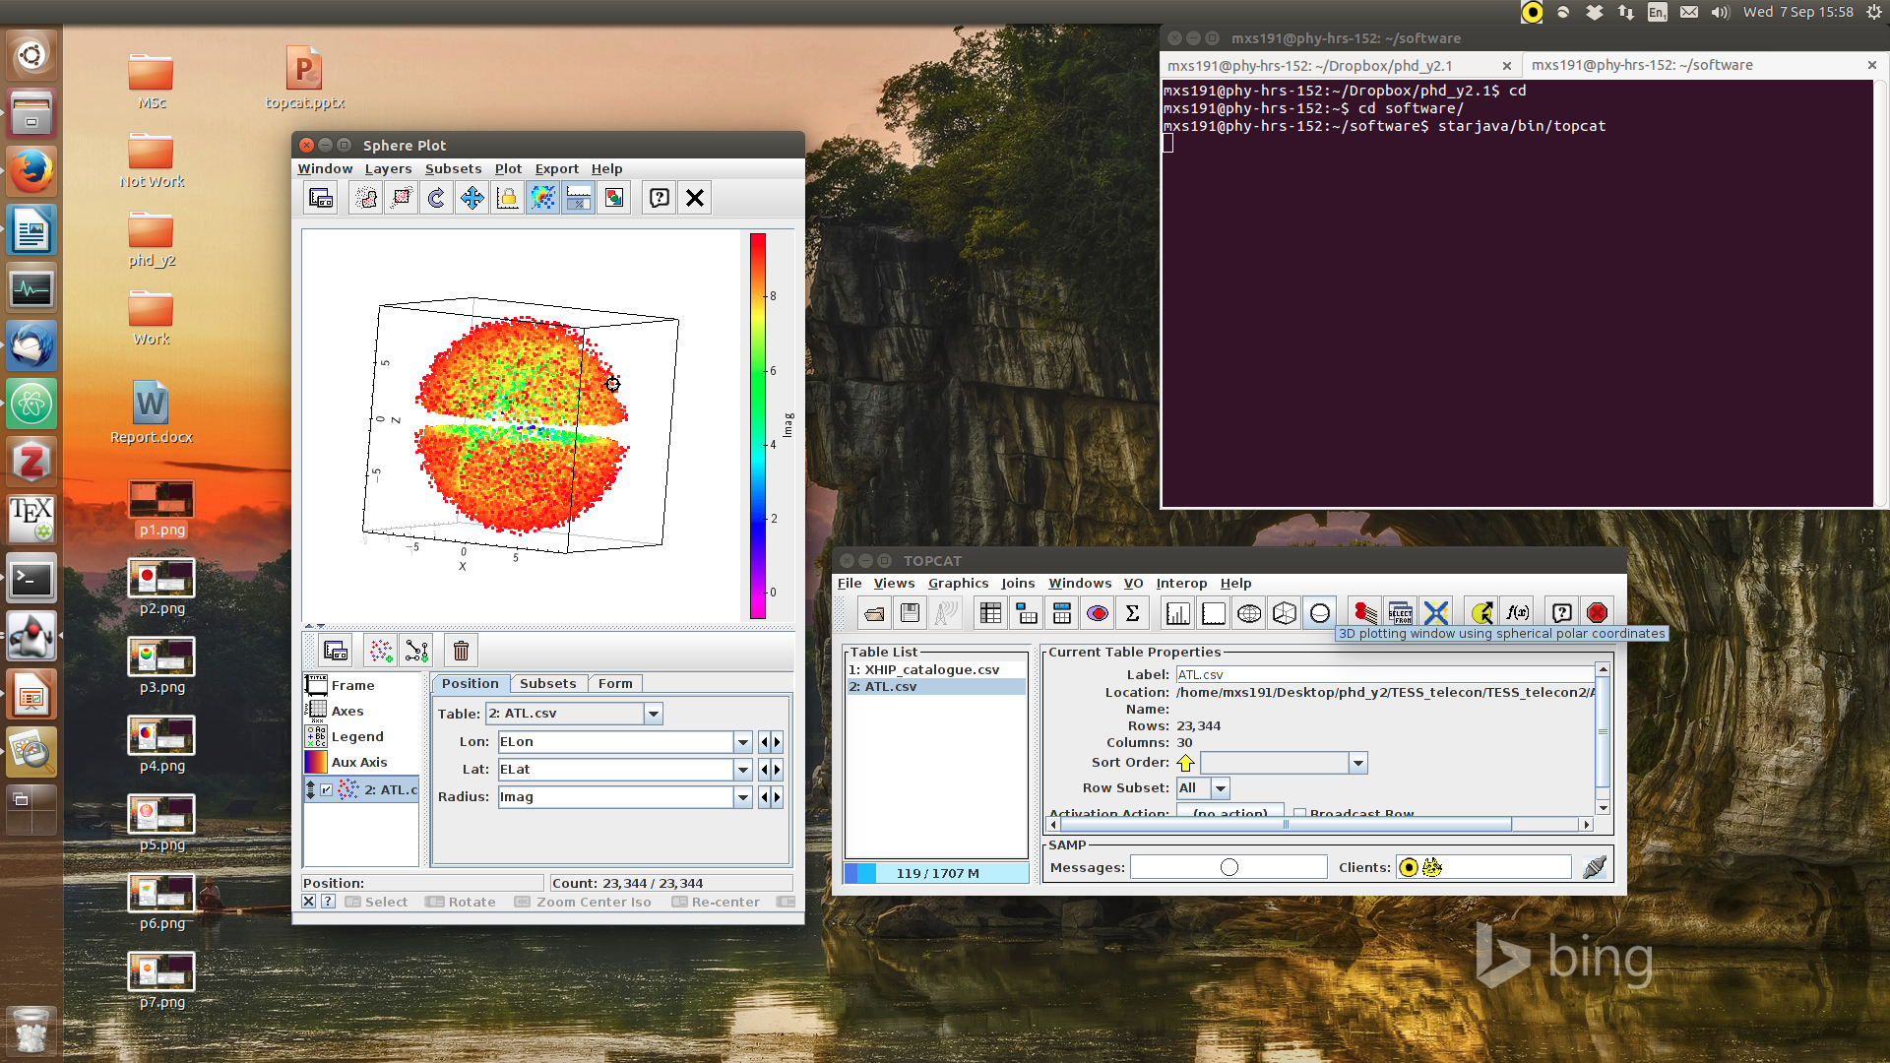
3D plotting using spherical polar coordinates

